Slide 1
Continuous
Deployment
Sundar Rajan Renganathan

Slide 2
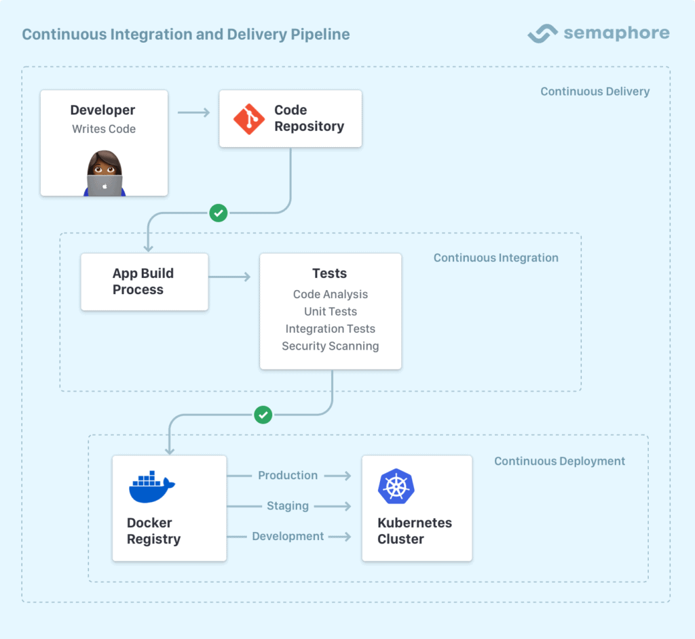
CI vs. CD vs. Continuous Delivery

Slide 3
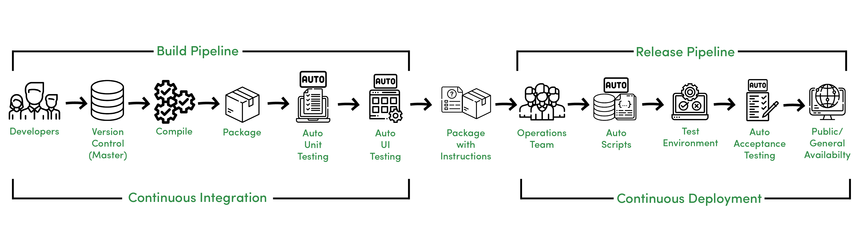
Continuous Integration & Deployment

Slide 4







CD Tools

Slide 5
Deployment Strategy
A deployment strategy is any technique employed by DevOps teams to successfully launch a new version of the software solution they provide. These techniques cover how network traffic in a production environment is transitioned from the old version to the new version.
Whenever we deploy an application, we have to carefully plan the process. We need to consider different aspects and how it affects the user experience. A deployment aims to install or upgrade the application without downtime and without disturbing the user experience.
Recreate Deployment Strategy
Blue-Green Deployment
Rolling Update
Canary Deployment
A/B Testing
Shadow Deployment

Slide 6
Recreate Deployment Strategy
Most basic strategy
Stop and then recreate the application
Pros
Easy to setup
Easy to manage
No additional cost
Cons
Downtime to end users
Rollback also causes downtime

Slide 7
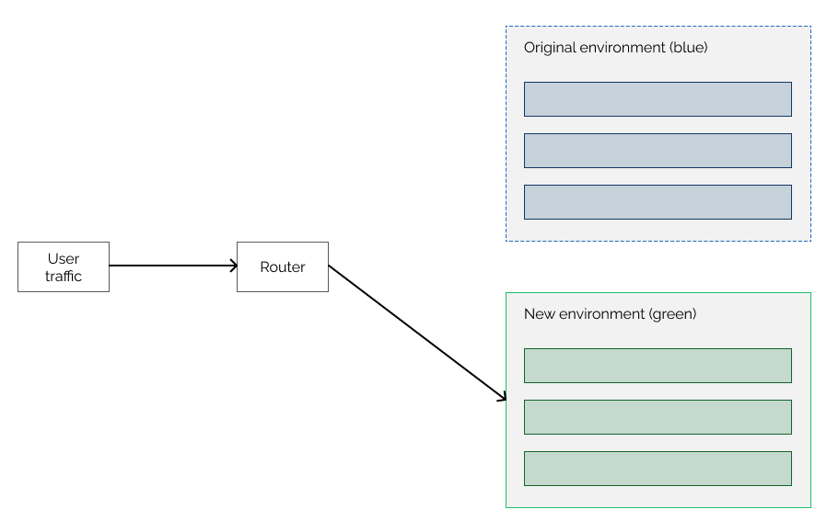
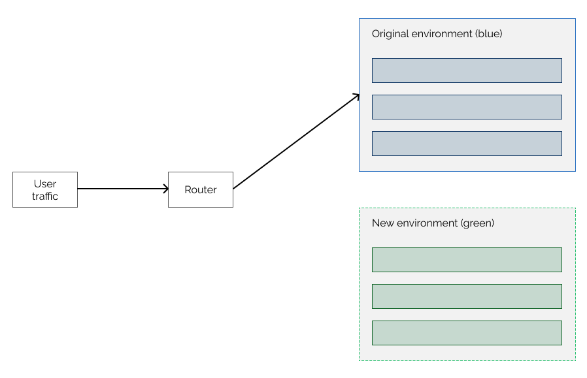
Blue-Green Deployment
The original, old version is called blue environment, and the new updated version is called green environment
Pros
No downtime
Rollback is faster
Cons
Additional infra cost
Backward compatibility issues may occur
Data sync up issues may occur

Slide 8
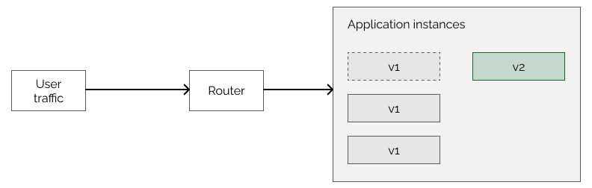
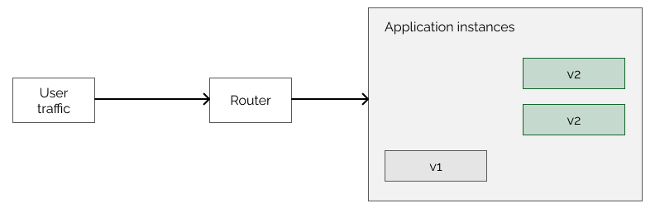
Rolling Update
applicable only if we have multiple instances of an application
Pros
No downtime
Rollback is faster
Works well for Containerized environment
Cons
Additional infra cost
User may get old functionality until all the instances are replaced.

Slide 9
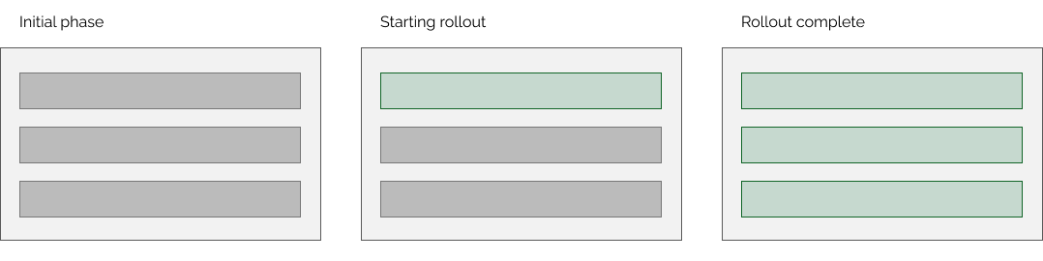
Canary Deployment
Iterative model
only a small part of the users receive the update
When we are sure that the update is successful, we can continue the rollout to all of the users
Pros
No downtime
Rollback is faster
High level of control
doesn’t need as many resources as the blue-green deployment because we are not duplicating the environments
Cons
Difficult to implement as it needs application arch changes
We need to select the target audience who gets the updates first

Slide 10
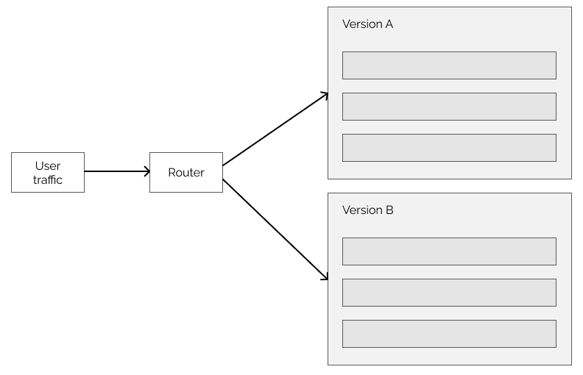
A/B Testing
deploys the update to a subset of users, just like canary deployments. However, A/B testing is mainly about getting feedback from the users about our changes. One part of the users keep using “version A” of the application while another part of them uses “version B”
Pros
No downtime
Rollback is faster
High level of control
Cons
Additional infra cost
Difficult to implement as it needs application arch changes
decide if we want to roll out the update to all users. This can be a complicated process.
We should consider technical aspects like application performance, but we might also want to receive feedback from users if they like the changes or not. For example, with A/B testing, we can measure if the users are more likely to click on a button if we replace the text on it.

Slide 11
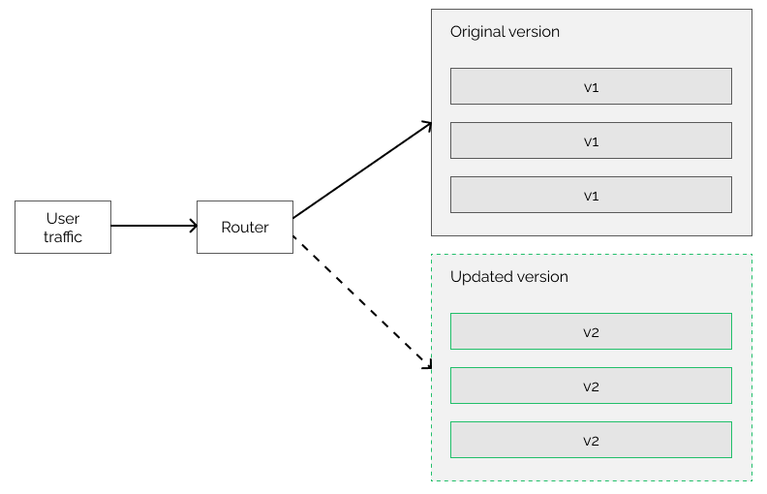
Shadow Deployment
two identical environments
both environments receive the requests, but the responses come from the original application version
Pros
No downtime
Rollback is faster
we don’t have the risk of introducing bugs to the system
we can monitor and test the new version under load.
Cons
Additional infra cost
need to ensure that the new version doesn’t have any side effects
Difficult to implement

Slide 12
Deployment Strategy – Consideration
There are things to consider when choosing a deployment strategy.
Long running connections need to be handled gracefully.
Database conversions can get tricky and will need to be done and rolled back along with the application.
If the application is a hybrid of microservices and traditional components downtime may be needed to complete the transition.
You need the infrastructure to do this.
If you have a non-isolated test environment, you can break both new and old versions.

